Slide 1

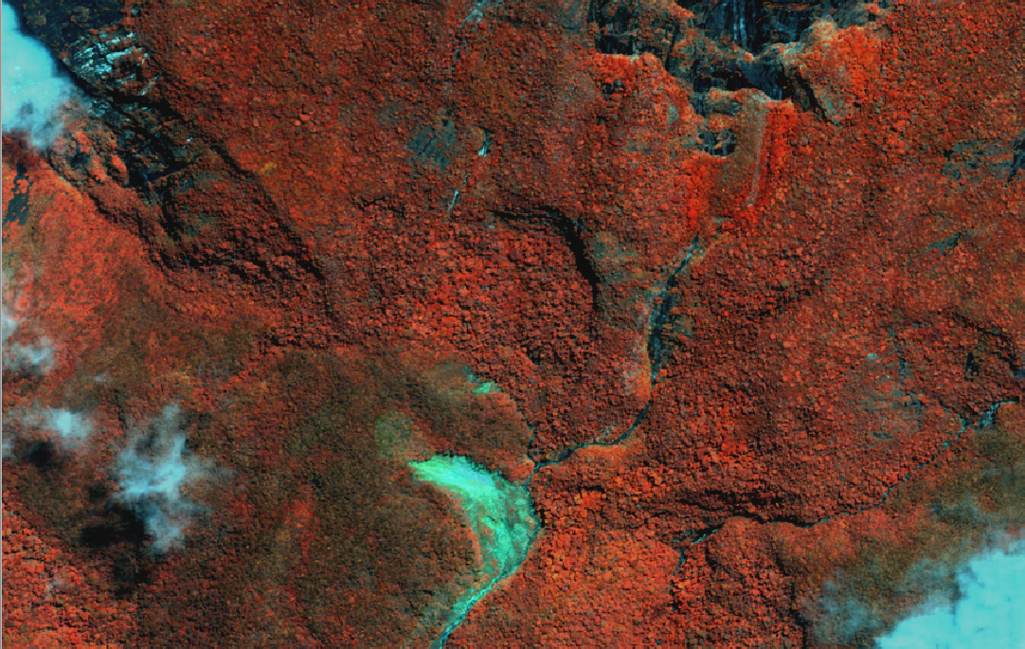
PRAGMA Biodiversity Expedition: Update on planned activities for June 2014
Reed Beaman 10 April 2014 University of Florida

Slide 2
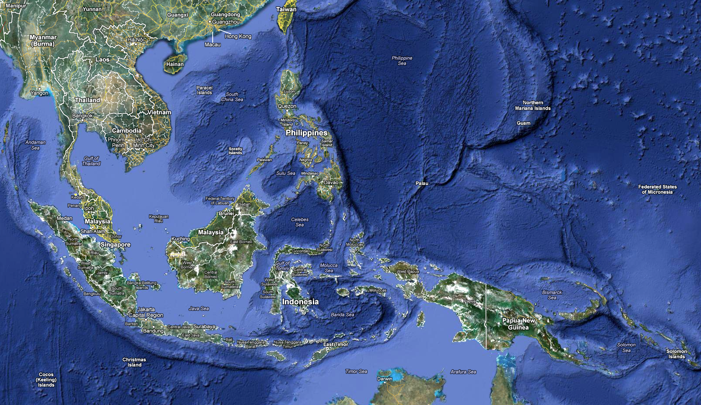
Kinabalu – Biodiversity Hotspot
Mount Kinabalu (4095 m), Sabah, Malaysia
Highest point between Himalaya and New Guinea and on island of Borneo
World Heritage site
Ca. 5,000 species of vascular plants in ca. 1,500 sq km area
Database of ca. 73,000 specimen records
Mt Kinabalu
Wallace’s Line

Slide 3
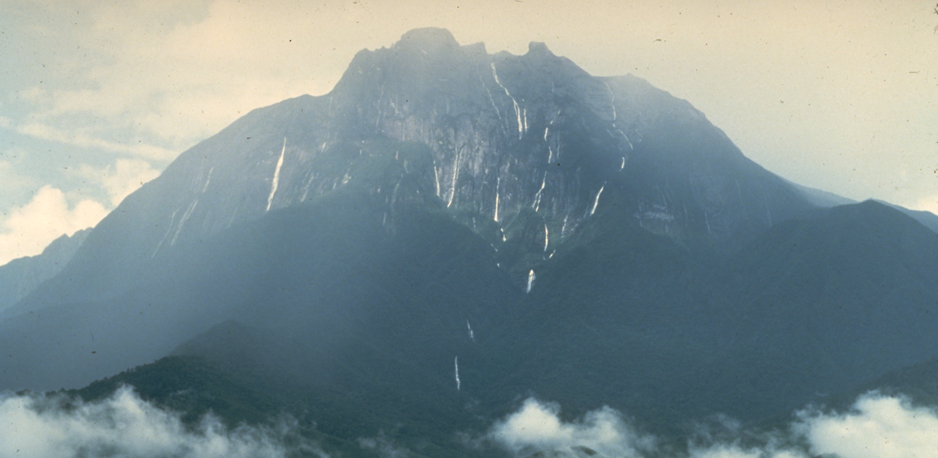
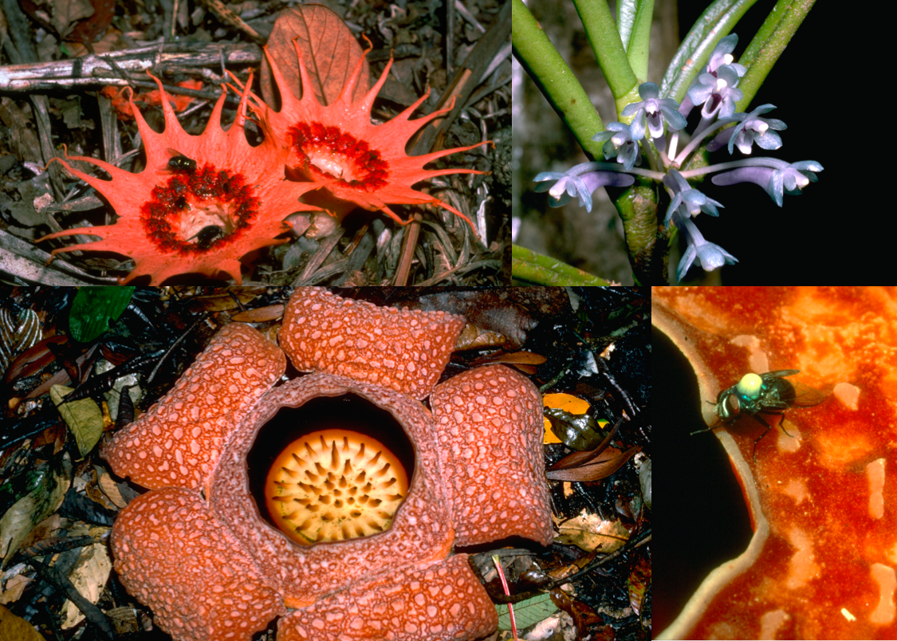
Drivers: What, why, where is the high diversity?
Elevation and climatic range
Precipitous topography causing
Geographic and reproductive isolation over short distances
Geological history of the Malay Archipelago
Diverse geology, localized edaphic conditions, ultramafic substrates;
Environmental instability: landslides, droughts, El Niño, climate change, flooding and glaciation

Slide 4
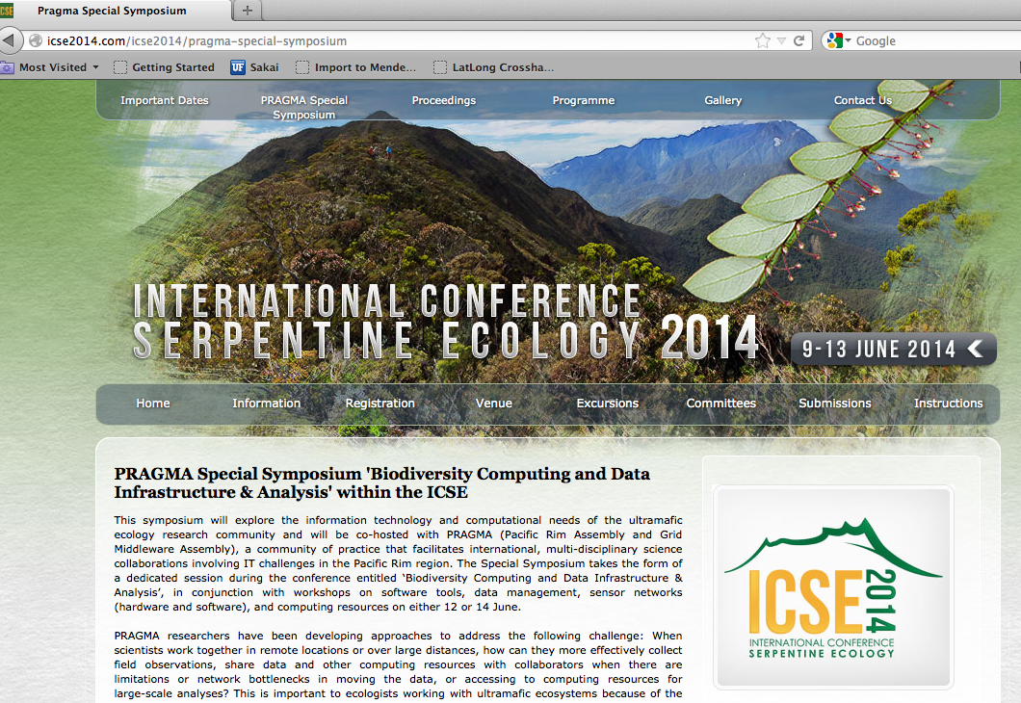

Slide 5
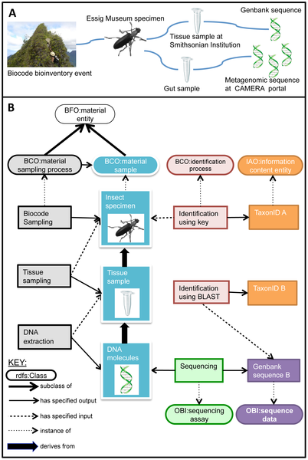
PRAGMA-tic activities
Pre-conference (June 4-8)
Unmanned Aerial Vehicle (UAV) data capture (U Queensland, Sabah Parks)
PRAGMA Mini-symposium (12 June)
Mobile application for field data capture
Lifemapper and GIS (tutorial, future requirements)
Data integration
Specimen digitization
Citation: Walls RL, Deck J, Guralnick R, Baskauf S, Beaman R, et al. (2014) Semantics in Support of Biodiversity Knowledge Discovery: An Introduction to the Biological Collections Ontology and Related Ontologies. PLoS ONE 9(3): e89606. doi:10.1371/journal.pone.0089606http://www.plosone.org/article/info:doi/10.1371/journal.pone.0089606

Slide 6
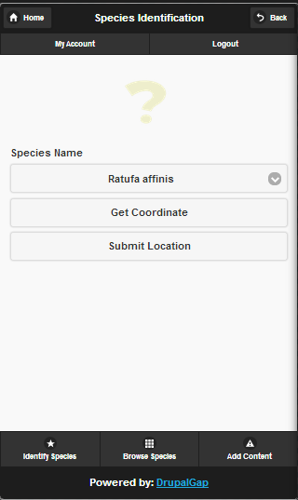
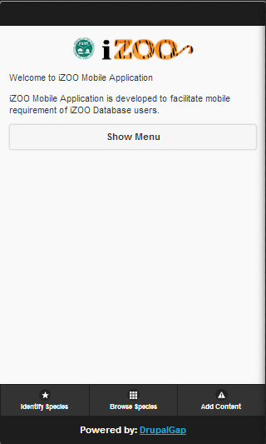
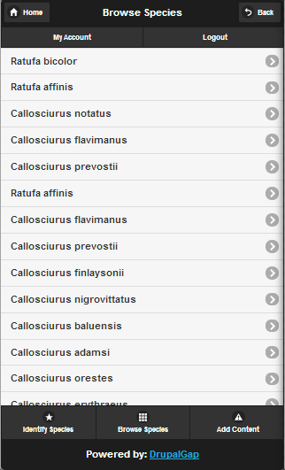
Mobile application for field data capture
Demo, tutorial and field testing (June 15-20) on Kinabalu
Universiti Tecknologi Malaysia
Nor Arlina Amirah bt Ahmad Ghani
Shahir Samsir
Use available data sources (Geoportal) for geospatial data and species occurrences
controlled vocabulary for field observations, trait data images.
Leverage on-board GPS and user metadata
Links up to servers (Twitter feed?)

Slide 7
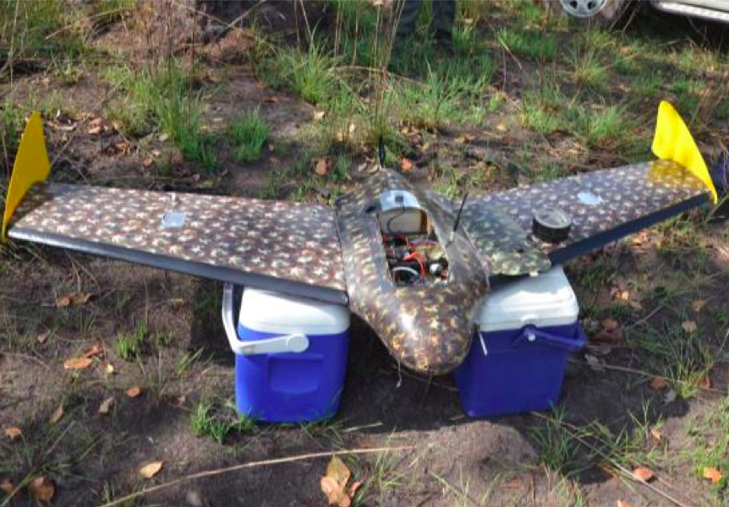
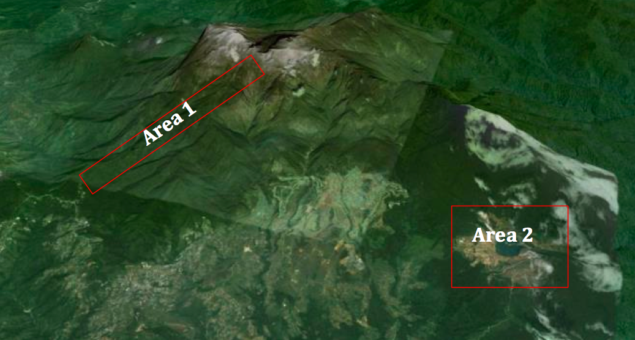
Capturing ultra-high resolution UAV-imagery on Mount Kinabalu
Pilot-project for modelling vegetation across geological substrates over an altitude gradient in Kinabalu Park
Peter Erskine Andrew Fletcher Antony van der Ent (The University of Queensland, Australia)
Rimi Repin (Sabah Parks, Sabah, Malaysia)
Reed Beaman (The University of Florida, USA)
Abdullah Kamaruddan (Minerals and Geosciences Department, Sabah, Malaysia)

Slide 8
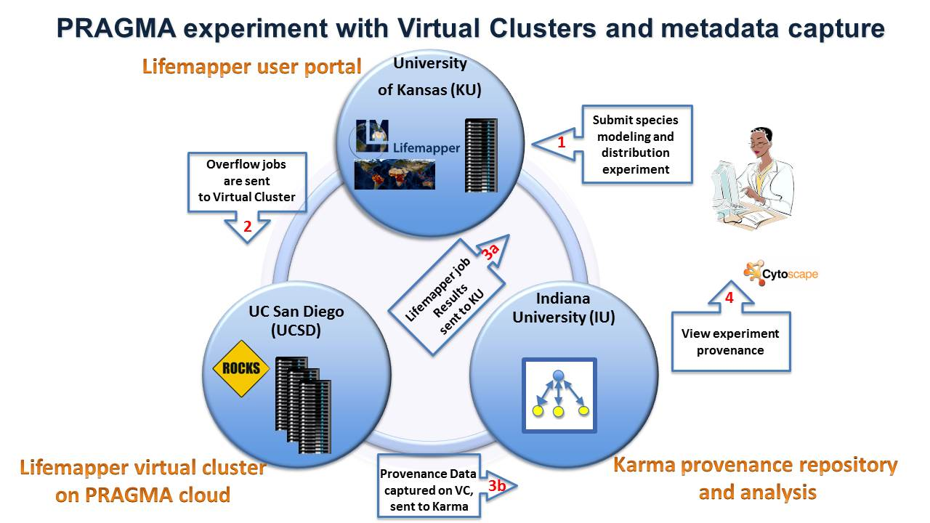
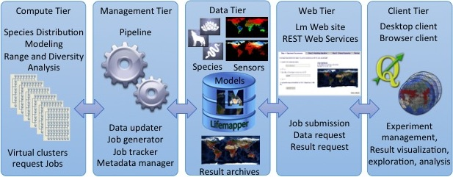
Lifemapper and GIS tutorials
Lifemapper software predicts species distributions
Improve efficiency, portability and capture provenance
Pushed Virtual Cluster technology, improved Lifemapper, incorporated Karma provenance
Goal is to share computation data in trusted network
Demo: Nadya Williams (UCSD),
Aimee Stewart (KU), Quan Zhou (IU)

Slide 9
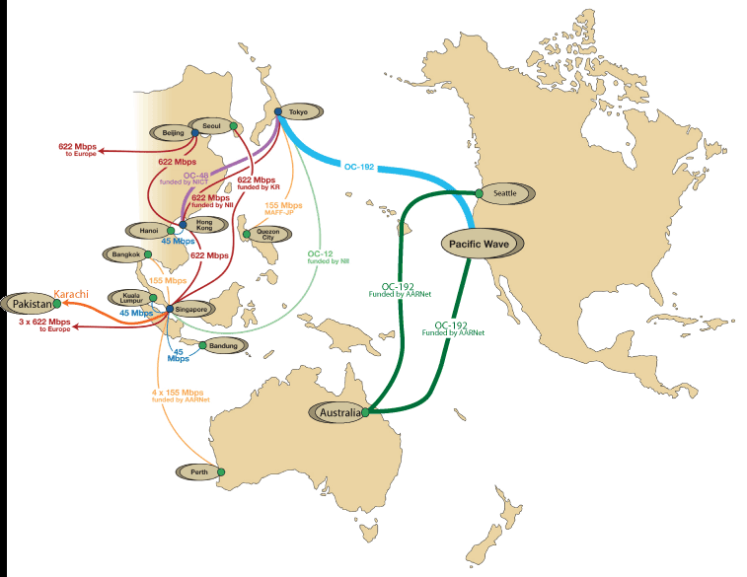


Trust Envelope
Discussion on rusted data integration
AIST Japan may have more compute resources
LifeMapper AIST
LifeMapper Virtual Cluster
Satellite imagery
Sensitive biodiversity data and UAV (Drone) imagery
Overlay Network
iDigBio, GBIF
Sensitive or licensed data may not be portable

